Slide 1
The Call of God Makes Us invincible
Act 23:11 But the following night the Lord stood by him and said, "Be of good courage, Paul; for as you have testified for Me in Jerusalem, so you must also bear witness at Rome."
Luk 10:19 Behold, I give you the authority to trample on serpents and scorpions, and over all the power of the enemy, and nothing shall by any means hurt you.

Slide 2
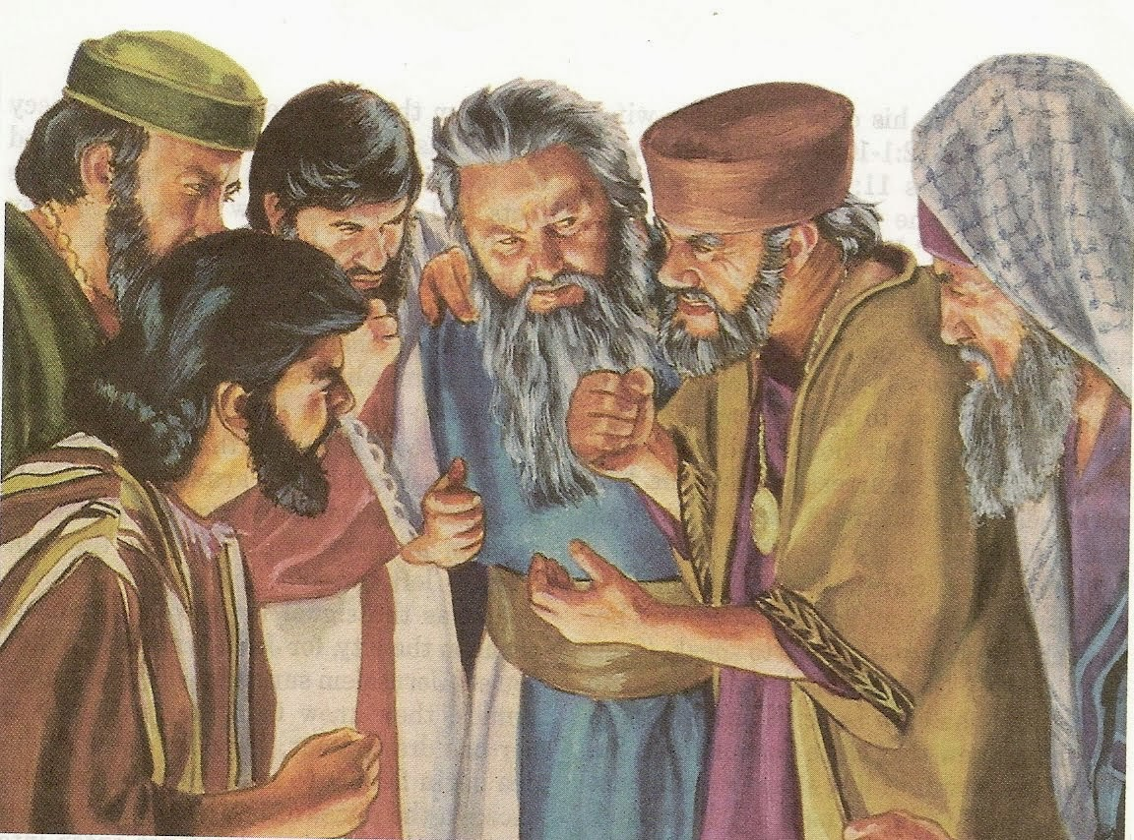
You are a target
Act 23:12 And when it was day, some of the Jews banded together and bound themselves under an curse/anathema, saying that they would neither eat nor drink till they had killed Paul.

Slide 3
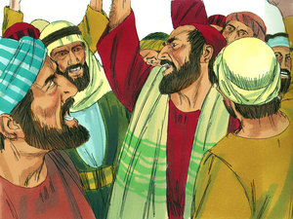
The unsaved Jews plotted against Paul
(16) Paul's sister's son heard of their lying in wait, and he came and entered into the castle and told Paul.

Slide 4
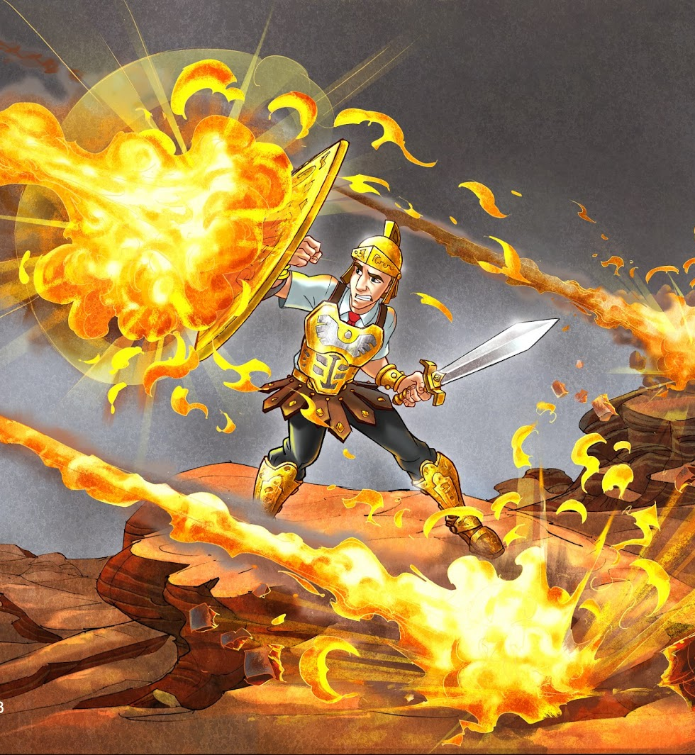
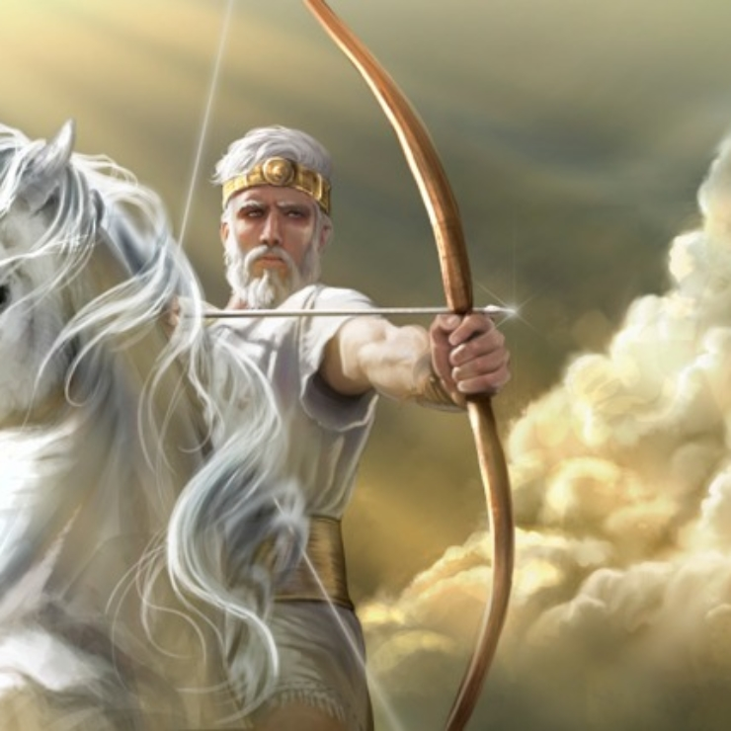
Preserve my life from fear of the enemy…Who have whet their tongue like a sword,
and have aimed their arrows …(4) That they may shoot in secret places at the perfect: (7)
God will shoot at them; With an
arrow suddenly shall they be wounded. Read Ps. 64

Slide 5
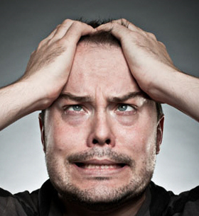
Job 5:12-13 He frustrates the devices of the crafty, so that their hands achieve no success. (13) He catches the wise in their own craftiness, and the schemes of the wily are brought to a quick end.
Psa_21:11 For they intended evil against You; They devised a plot which they are not able to perform.

Slide 6
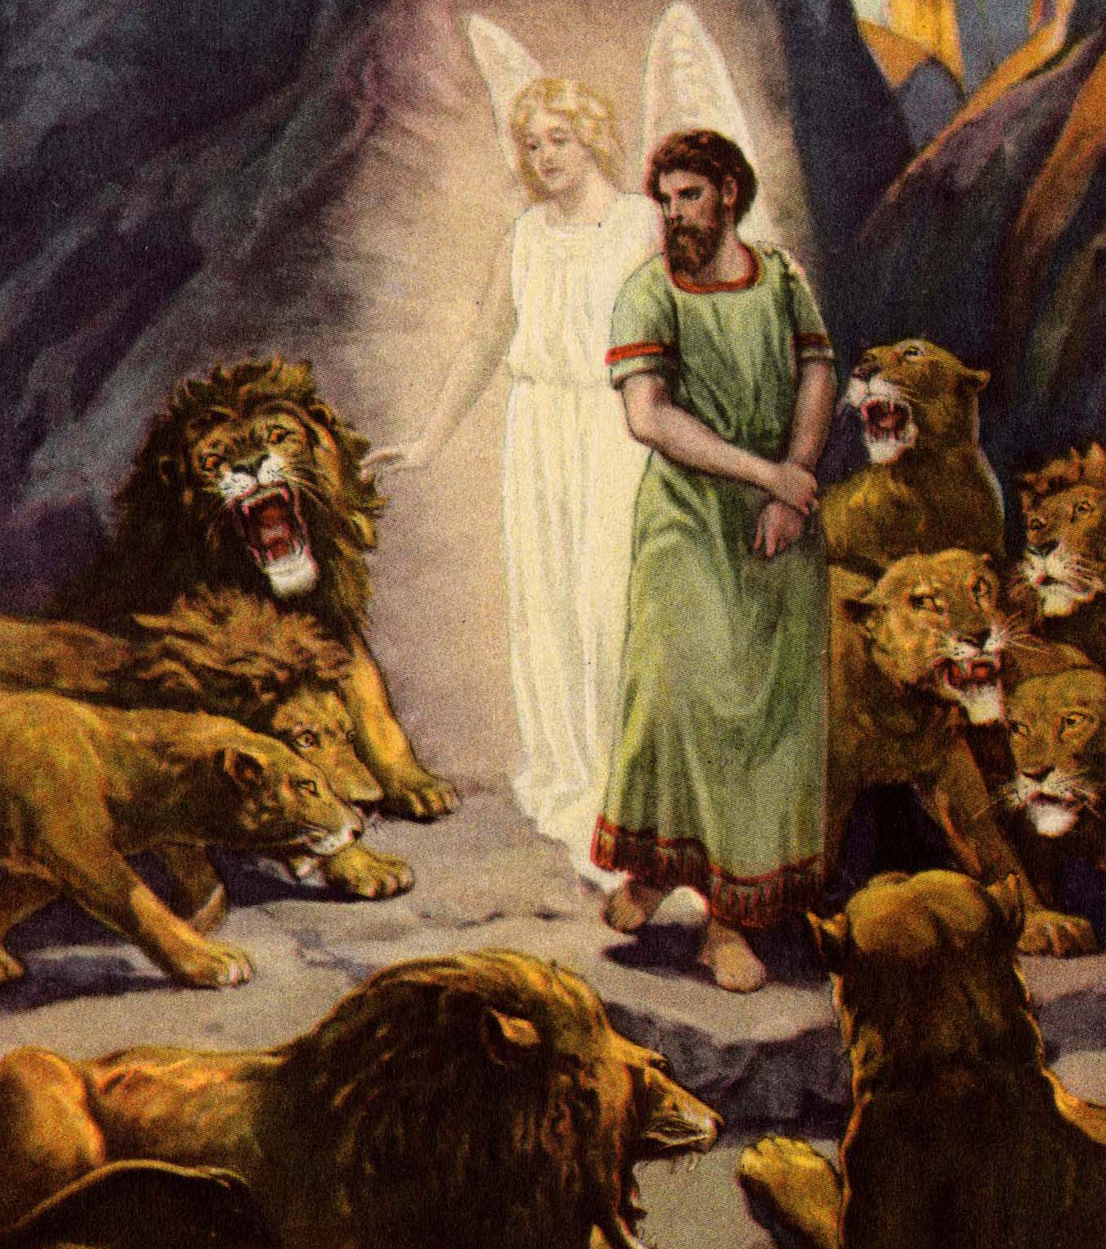
YAY, for the home team!!!
YAY, for the home team???
Heb 11:32…Gideon and Barak and Samson and Jephthah, also of David and Samuel and the prophets: (33) who through faith subdued kingdoms, worked righteousness, obtained promises, stopped the mouths of lions, (34) quenched the violence of fire, escaped the edge of the sword, out of weakness were made strong, became valiant in battle, turned to flight the armies of the aliens…
Heb 11:35…Others were tortured…(36) Still others had trial of mockings and scourgings, yes, and of chains and imprisonment. (37) They were stoned, they were sawn in two, were tested, were slain with the sword. They wandered about in sheepskins and goatskins, being destitute, afflicted, tormented, (38)… They wandered in deserts
and mountains, in dens
and caves of the earth.

Slide 7
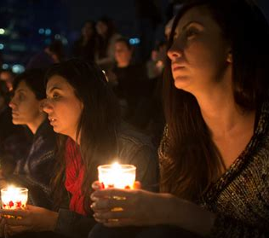
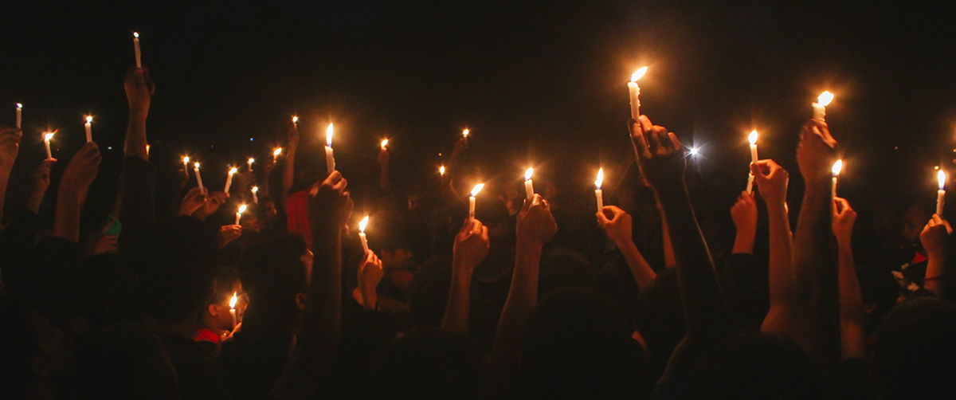
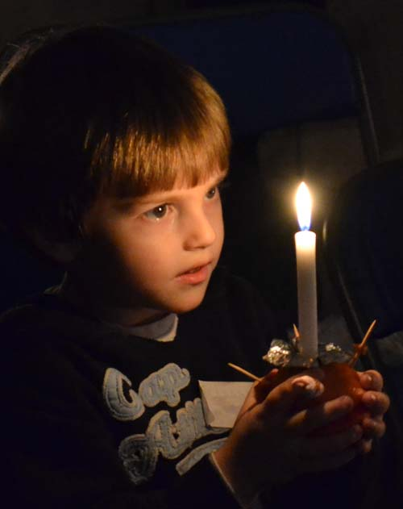
You are dangerous
…to the enemy
2Co 4:4 whose minds the god of this age has blinded, who do not believe, lest the light of the gospel of the glory of Christ, who is the image of God, should shine on them.

Slide 8
Act 23:17 Then Paul called one of the centurions to him and said, "Take this young man to the commander, for he has something to tell him."
YOU ARE AN

Slide 9
The Plot Revealed
Act 23:18 So he took him and brought him to the commander and said, "Paul the prisoner called me to him and asked me to bring this young man to you. He has something to say to you." (19) Then the commander took him by the hand, went aside, and asked privately, "What is it that you have to tell me?"
(20) And he said, "The Jews have agreed to ask that you bring Paul down to the council tomorrow, as though they were going to inquire more fully about him. (21) But do not yield to them, for more than forty of them lie in wait for him, men who have bound themselves by an oath that they will neither eat nor drink till they have killed him; and now they are ready, waiting for the promise from you." (22) So the commander let the young man depart, and commanded him, "Tell no one that you have revealed these things to me."

Slide 10
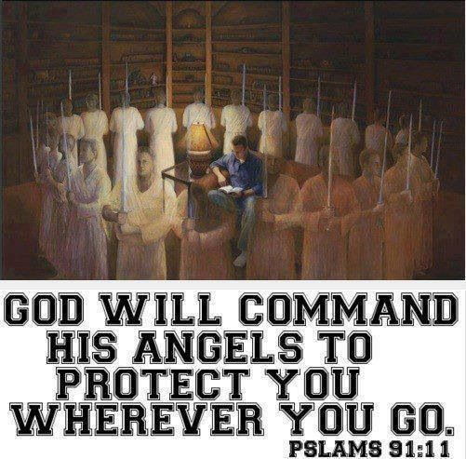
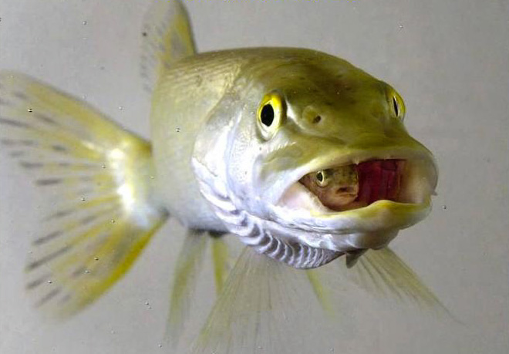
You are protected
Act 23:23 And he called for two centurions, saying, "Prepare two hundred soldiers, seventy horsemen, and two hundred spearmen to go to Caesarea at the third hour of the night; 24 and provide mounts to set Paul on, and bring him safely to Felix the governor."
2Th 3:3 But the Lord is faithful, who will establish you and guard you from the evil one.
Psa 46:1-2 …God is our refuge and strength, A very present help in trouble. (2) Therefore we will not fear…
Luk 10:19-20 Behold, I give you the authority to trample on serpents and scorpions, and over all the power of the enemy, and nothing shall by any means hurt you.

Slide 11
Col 3:3 For you died, and your life is hidden with Christ in God. Eph 2:6 … and raised us up together, and made us sit together in the heavenly places in Christ Jesus,
Can’t touch this… grrr

Slide 12
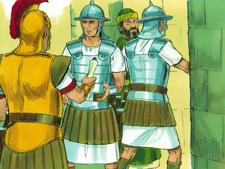
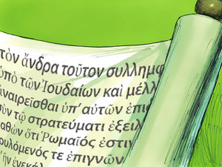
You Are Guided By Circumstances
Paul’s Fourth Missionary Journey Begins
(Hi ho, Hi ho, it’s off to Rome I Go)
(25) And he wrote a letter after this form: (26) Claudius Lysias unto the most excellent governor Felix, greeting. (27) This man was seized by the Jews, and was about to be slain of them, when I came upon them with the soldiers and rescued him, having learned that he was a Roman. (28) And desiring to know the cause wherefore they accused him, I brought him down unto their council: (29) whom I found to be accused about questions of their law, but to have nothing laid to his charge worthy of death or of bonds. (30) And when it was shown to me that there would be a plot against the man, I sent him to thee forthwith, charging his accusers also to speak against him before thee. (31) So the soldiers, as it was commanded them, took Paul and brought him by night to Antipatris. (32) But on the morrow they left the horsemen to go with him, and returned to the castle:

Slide 13
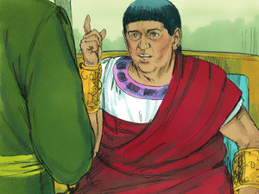
You Get To Witness To Mr. Happy Sinner
Act 23:33-35 When they came to Caesarea and had delivered the letter to the governor, they also presented Paul to him. (34) And when the governor had read it, he asked what province he was from. And when he understood that he was from Cilicia, (35) he said, "I will hear you when your accusers also have come." And he commanded him to be kept in Herod's Praetorium.
Happy, Ha
Happy

