Slide 1
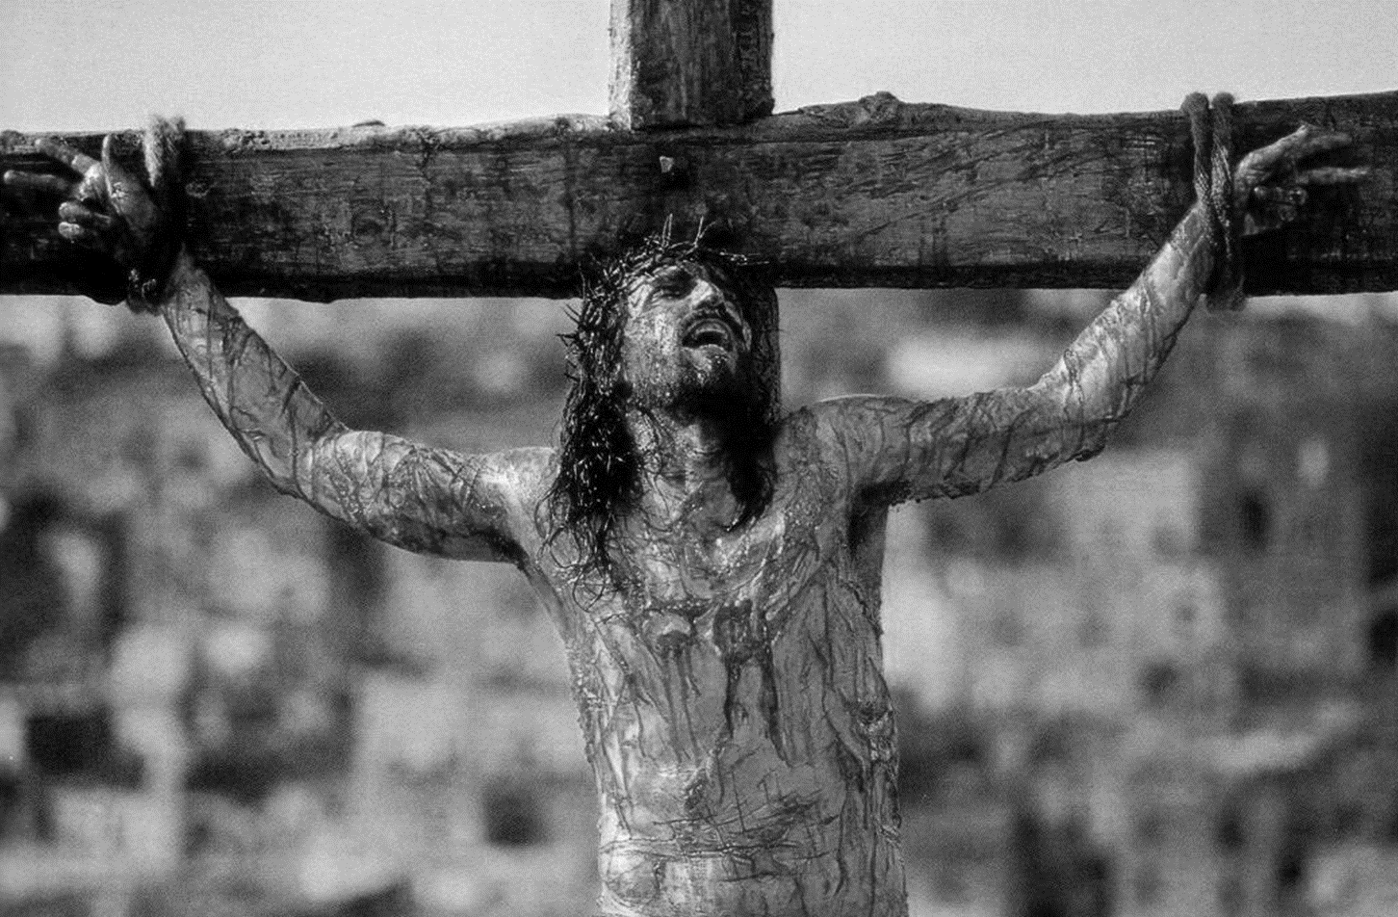
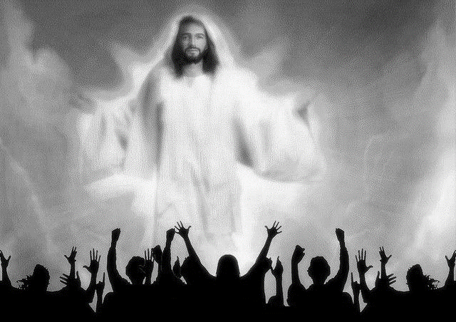
Heb 12:1…let us lay aside every weight, and the sin which so easily ensnares us, and let us run with endurance the race that is set before us,
(2) looking unto Jesus, the author and finisher of our faith, who for the joy that was set before Him endured the cross, despising the shame, and has sat down at the right hand of the throne of God.
FINISH YOUR RACE
ACTS 20:17-38
(3) For consider Him who endured such hostility from sinners against Himself, lest you become weary and discouraged in your souls.

Slide 2
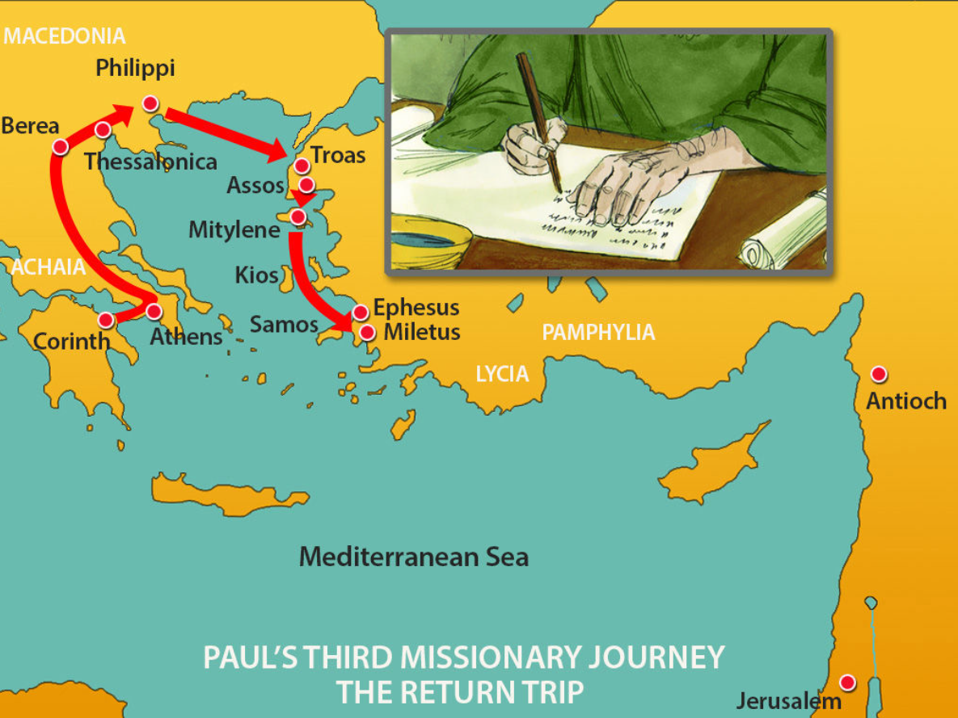
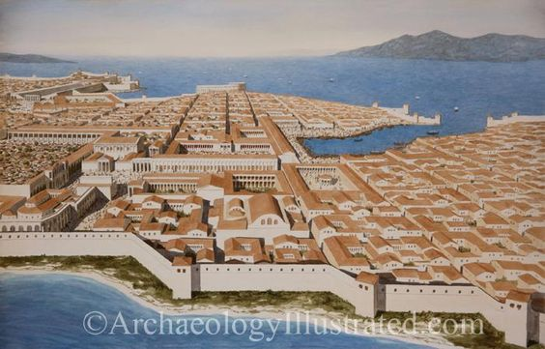
Paul Calls for the Elders of the church
Act 20:17 From Miletus he sent to Ephesus and called for the elders of the church.
What is an Elder? An elder is a spiritually mature leader of the church that has been appointed to oversee and shepherd the church.
Elder – Gr. πρεσβύτερος – presbuteros
Overseer – Gr. ἐπίσκοπος - episkopos (Acts 20:28)
Shepherd/pastor - Gr. ποιμαίνω - poimainō - pastor = poimēn (Acts 20:28)
Notice the plurality of the elders.
Tit 1:5 For this reason I left you in Crete, that you should set in order the things that are lacking, and appoint elders in every city as I commanded you—
1Ti 5:17 Let the elders who rule well be counted worthy of double honor, especially those who labor in the word and doctrine.

Slide 3
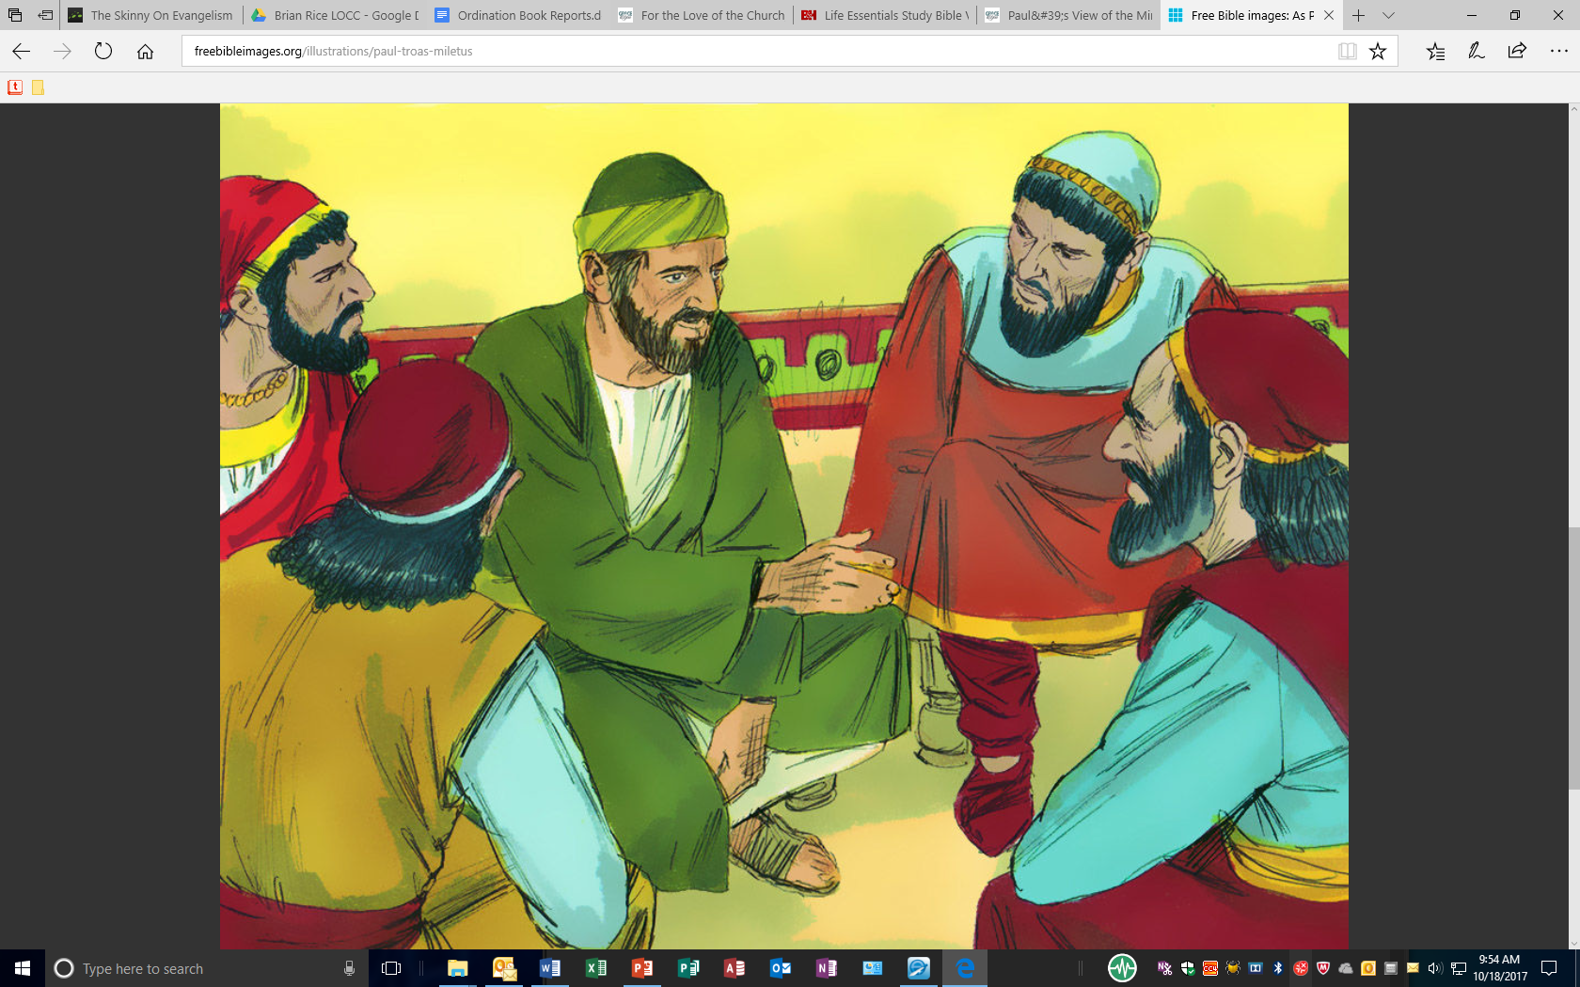
Paul’s Manner of Life Among the Ephesians
18 And when they had come to him, he said to them: "You know, from the first day that I came to Asia, in what manner I always lived among you, 19 serving the Lord with all humility, with many tears and trials which happened to me by the plotting of the Jews; 20 how I kept back nothing that was helpful/profitable, but proclaimeit to you, and taught you publicly and from house to house, 21 testifying to Jews, and also to Greeks, repentance toward God and faith toward our Lord Jesus Christ.
1. Paul was Consistent in the midst of trials
2. Paul was no man pleaser – held nothing back that would profit the church
3. Paul taught the church publicly and privately
4. Paul consistent in his message – repentance and faith in Christ

Slide 4
Paul’s Desire to Finish His Ministry
Act 20:22-24 And see, now I go bound in the spirit to Jerusalem, not knowing the things that will happen to me there, (23) except that the Holy Spirit testifies in every city, saying that chains and tribulations await me.
(24) But none of these things move me; nor do I count my life dear to myself, so that I may finish my race with joy, and the ministry which I received from the Lord Jesus, to testify to the gospel of the grace of God.
Heb 12:1 Therefore we also, since we are surrounded by so great a cloud of witnesses, let us lay aside every weight, and the sin which so easily ensnares us, and let us run with endurance the race that is set before us, 2 looking unto Jesus, the author and finisher of our faith, who for the joy that was set before Him endured the cross, despising the shame, and has sat down at the right hand of the throne of God.

Slide 5
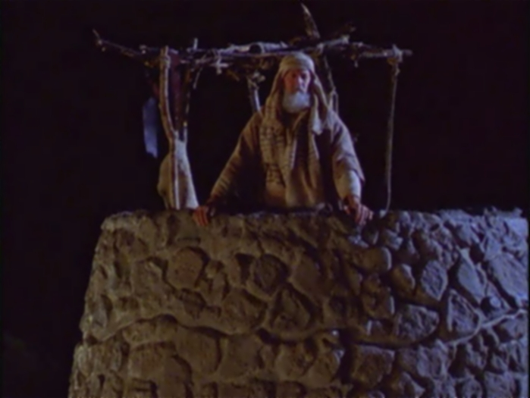
Paul’s Innocence
Paul Alludes to Blood Guiltiness in the Old Testament
Act 20:25-27 "And indeed, now I know that you all, among whom I have gone preaching the kingdom of God, will see my face no more. (26) Therefore I testify to you this day that I am innocent of the blood of all men.(27) For I have not shunned to declare to you the whole counsel of God.
Eze 3:17-21 "Son of man, I have made you a watchman for the house of Israel; therefore hear a word from My mouth, and give them warning from Me: (18) When I say to the wicked, 'You shall surely die,' and you give him no warning, nor speak to warn the wicked from his wicked way, to save his life, that same wicked man shall die in his iniquity; but his blood I will require at your hand. (19) Yet, if you warn the wicked, and he does not turn from his wickedness, nor from his wicked way, he shall die in his iniquity; but you have delivered your soul. (20) "Again, when a righteous man turns from his righteousness and commits iniquity, and I lay a stumbling block before him, he shall die; because you did not give him warning, he shall die in his sin, and his righteousness which he has done shall not be remembered; but his blood I will require at your hand. (21) Nevertheless if you warn the righteous man that the righteous should not sin, and he does not sin, he shall surely live because he took warning; also you will have delivered your soul."

Slide 6
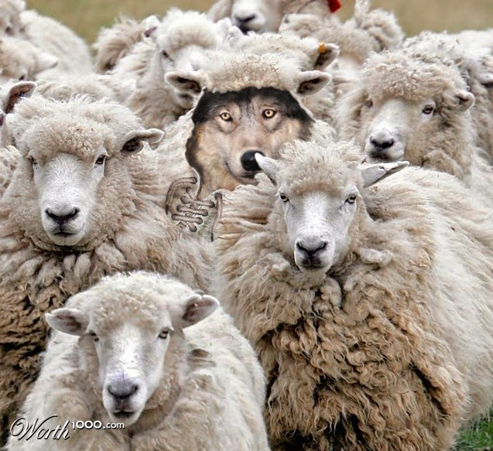
Paul’s Warning Against False Teachers
They arise from within and without
Act 20:28-31 Therefore take heed to yourselves and to all the flock, among which the Holy Spirit has made you overseers, to shepherd the church of God which He purchased with His own blood. (29) For I know this, that after my departure savage wolves will come in among you, not sparing the flock. (30) Also from among yourselves men will rise up, speaking perverse things, to draw away the disciples after themselves. (31) Therefore watch, and remember that for three years I did not cease to warn everyone night and day with tears.

Slide 7
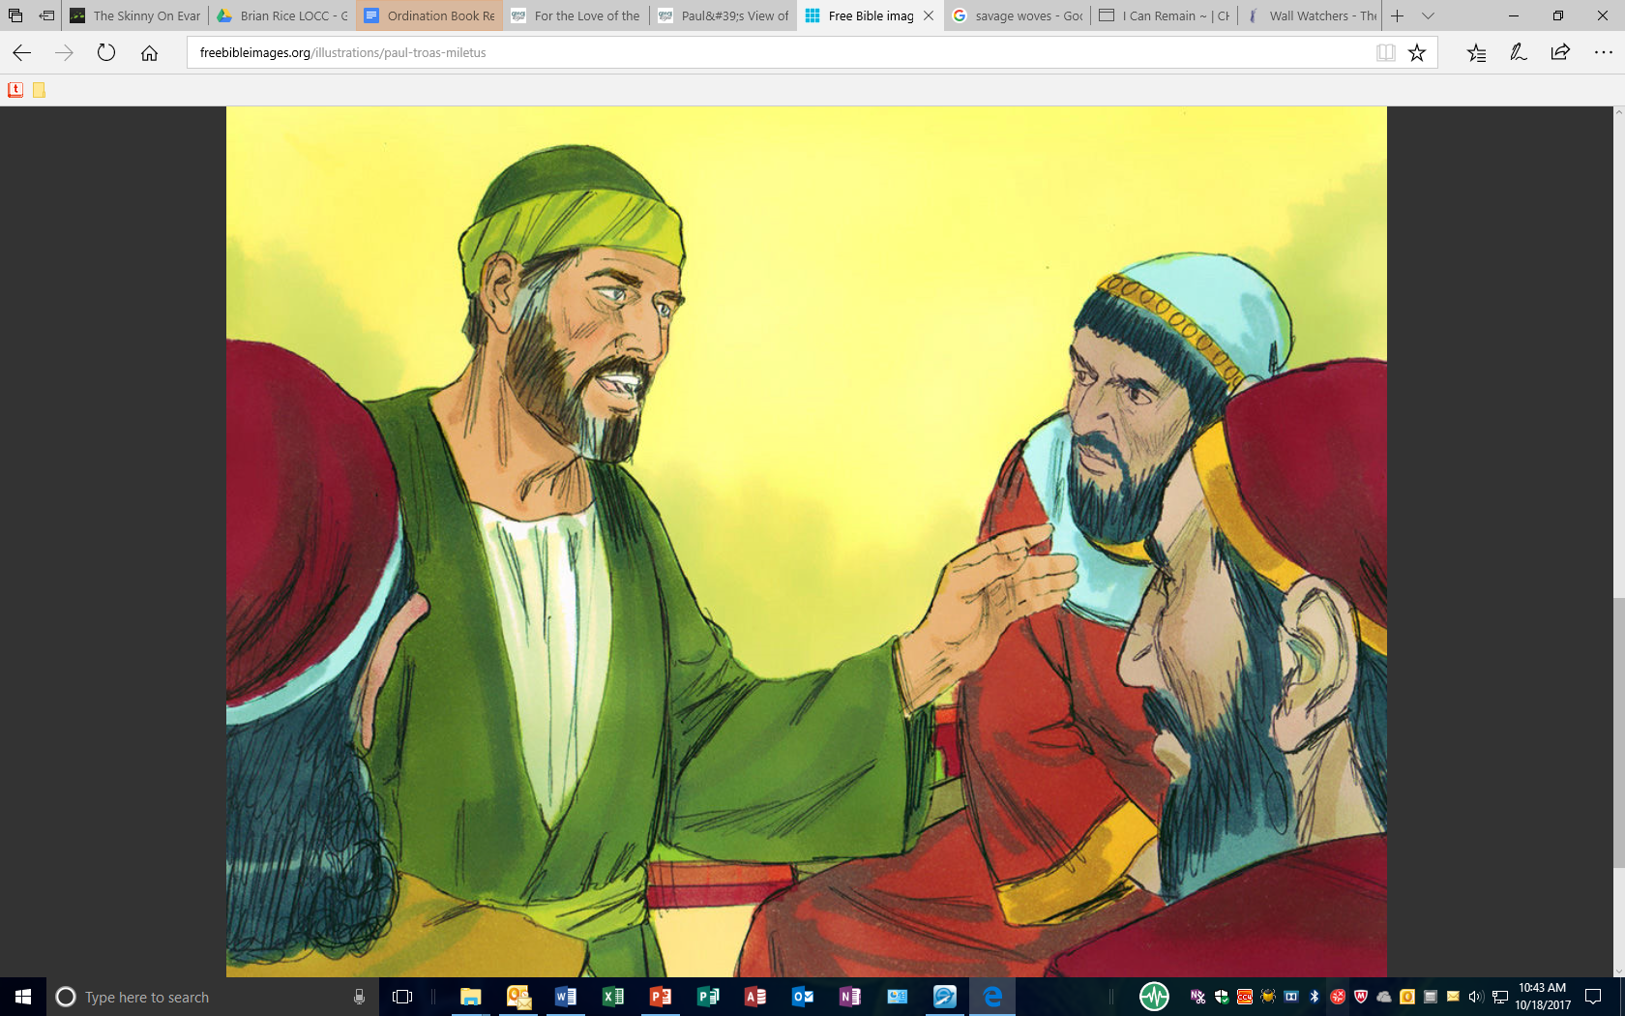
Act 20:32-35 "So now, brethren, I commend you to God and to the word of His grace, which is able to build you up and give you an inheritance among all those who are sanctified. (33) I have coveted no one's silver or gold or apparel. (34) Yes, you yourselves know that these hands have provided for my necessities, and for those who were with me. (35) I have shown you in every way, by laboring like this, that you must support the weak. And remember the words of the Lord Jesus, that He said, 'It is more blessed to give than to receive.' " Act 20:35-38 I have shown you in every way, by laboring like this, that you must support the weak. And remember the words of the Lord Jesus, that He said, 'It is more blessed to give than to receive.' "

Slide 8
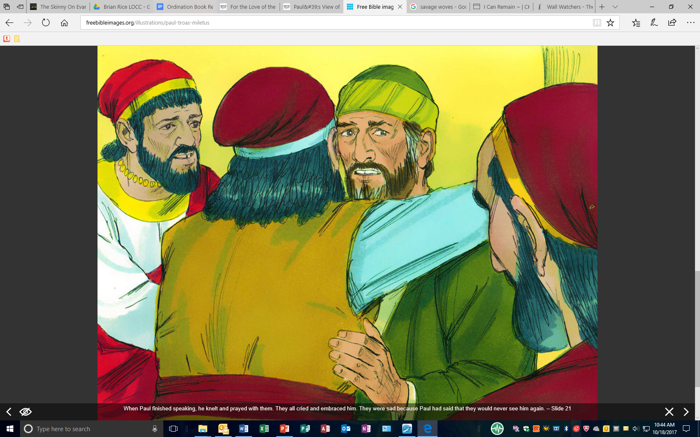
Paul’s Final Farewell to the Ephesian Elders
(36) And when he had said these things, he knelt down and prayed with them all. (37) Then they all wept freely, and fell on Paul's neck and kissed him, (38) sorrowing most of all for the words which he spoke, that they would see his face no more. And they accompanied him to the ship.

