Slide 1
A Biblical Measuring Stick
Reading Between The Lines Acts 20:1-6

Slide 2
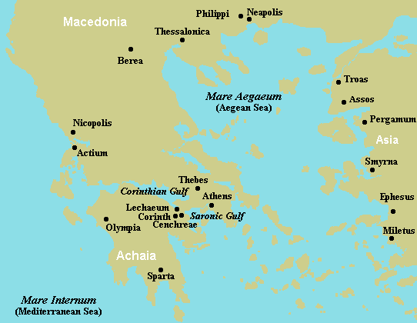
Paul Goes To Macedonia
Act 20:1-2 After the uproar had ceased, Paul called the disciples to himself, embraced them, and departed to go to Macedonia. (2) Now when he had gone over that region and encouraged them with many words, he came to Greece and stayed three months (v.3).
Breakdown of Acts 20
From Ephesus to Troas
Acts 20:1-6
Paul’s ministry in Troas
Acts 20:7-12
From Troas to Miletus
Acts 20:13-17
Paul’s ministry to the Ephesian elders
Acts 20:18-38
.

Slide 3
Act 20:3….And when the Jews plotted against him as he was about to sail to Syria, he decided to return through Macedonia. (4) And Sopater of Berea accompanied him to Asia—also Aristarchus and Secundus of the Thessalonians, and Gaius of Derbe, and Timothy, and Tychicus and Trophimus of Asia. (5) These men, going ahead, waited for us (Paul and Luke) at Troas. (6) But we sailed away from Philippi after the Days of Unleavened Bread, and in five days joined them at Troas, where we stayed seven days. (Remember Luke stayed at Philippi in Acts 16)

